Slide 1


CALEA Accreditation
Tacoma Police Department

Slide 2
History
1960’s and 1970’s, there was a loss of confidence in Law Enforcement’s ability to prepare for and deal with current events.
Law Enforcement officers were viewed as under-trained.
Selection and hiring practices were often discriminatory.
Policies and procedures were poorly written, outdated, or sometimes nonexistent.

Slide 3




CALEA Accreditation
Commission on Accreditation for Law Enforcement Agencies.
Created in 1979 as a credentialing authority through joint efforts of law enforcement’s major executive associations.
International Association of Chiefs of Police (IACP)
National Organization of Black Law Enforcement Executives (NOBLE)
National Sheriffs’ Association (NSA)
Police Executive Research Forum (PERF)

Slide 4
CALEA Accreditation
A collaborative establishment of accepted Law Enforcement Standards of professional excellence.
Voluntarily subscribed to by participating agencies who are subject to an annual assessment.
Agency is formally recognized by an international authoritative body.

Slide 5
CALEA Accreditation Commission
The Commission Board is composed of 21members (11 Law Enforcement Professionals and 10 representatives from public and private sector) that governs CALEA.
Commissioners are appointed by the founding associations.
Each of the founding organizations have one appointment and research consensus on others.
Commissioners come from a broad range of public safety professionals including sheriffs, chiefs of police, judges, mayors, city managers, collegiate professors, investigative agency directors, and other related business fields.

Slide 6
CALEA Standards Manuals
CALEA Commission creates Standards Manuals for the respective disciplines of Law Enforcement, Communication Centers, Training Academies, and Campus Security.
Every enrolled agency subscribes and receives the Standards Manual through PowerDMS. No agency can amend, alter, or change the manual.
Manual contains over 180+ Standards that govern what an agency has to do or have.
PowerDMS is used for file construction and uploading proofs of compliance.
Every agency has an Accreditation Manager who requests, locates, compiles, uploads, and highlights the proofs of compliance for the assessment.

Slide 7
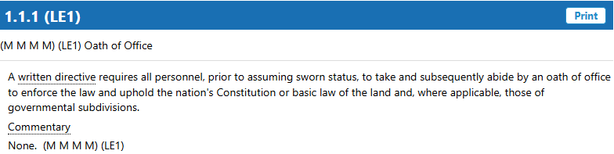
Standard Construction
A Standard is a declarative statement that places a clear requirement, or multiple requirements, on the agency.
Can have Commentary that helps explain the intent of the standard.

Slide 8
Written Directive
Is official or authoritative written instruction.
Written document used to guide or affect performance or conduct that is binding on the agency and personnel.
  Policies and Procedures
  Rules and Regulations
  City Ordinances
  State or Federal Law
  General or Special Orders

Slide 9
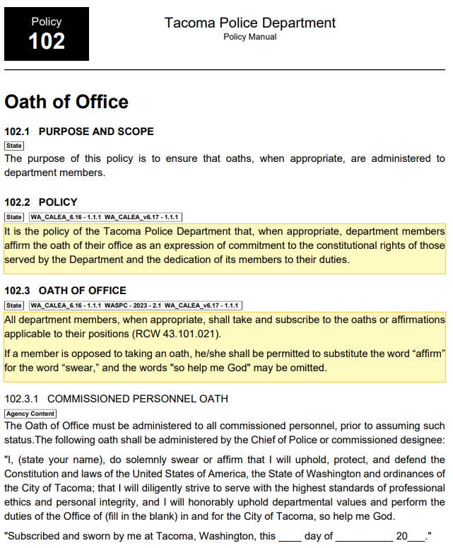

Slide 10
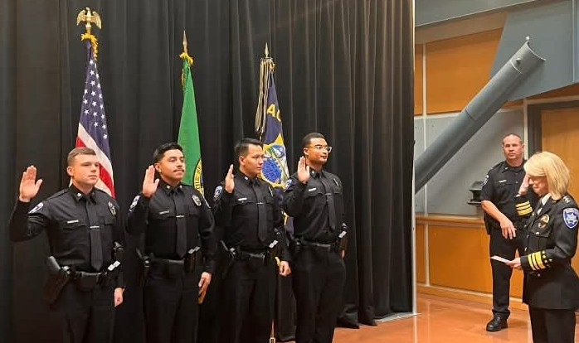
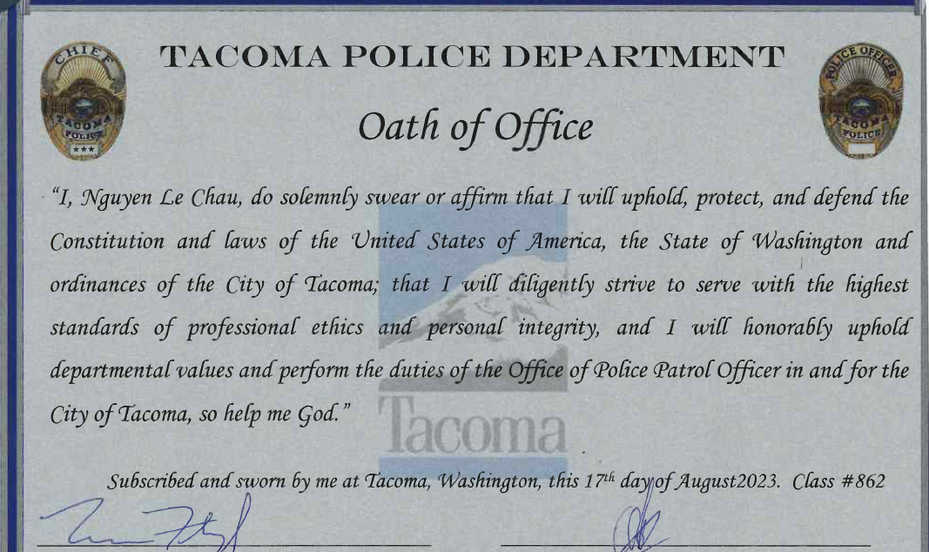
Proof of Compliance
Something that demonstrates that agencies adhere to the Standard and their Written Directive.
  Forms and Reports
  Training rosters
  Videos and Pictures
  News articles
  Websites

Slide 11
CALEA Assessment Remote Web Based
The Tacoma Police Department goes through a Remote Web Based Assessment annually.
CALEA Compliance Service Member (CSM) reviews, assesses, and comments on the required proof of compliance for 180+ Standards in about a week.
CSM will provide you daily feedback, questions or concerns with Written Directive or Proof of Compliance.
Conduct four (4) formal Areas of Interest phone interviews with representing agency members.

Slide 12
CALEA
On-Site Assessment
Every fourth (4th) year, CALEA conducts an On-Site Assessment. They send out a CALEA Assessor for 3 days to conduct:
Introduction interview with Chief of Police for insight on department vision, mission, and values.
Conduct four (4) formal presentations on Focus Areas chosen by department and CALEA.
Observation of facilities, fleet, and other organizational structures.

Slide 13
CALEA
On-Site Assessment
In-person interviews with agency members such as Command Staff, supervisors, managers, police officers, and support personnel.
Telephone or in-person interviews with community members, business owners, community organizers, and local government.
Exit Interview with Chief of Police where they receive real-time feedback of their continued compliance and accreditation status.

Slide 14
CALEA Accreditation
Agency receives initial or reaccreditation and it starts the cycle continues.
Remote and On-Site Assessments are based on your initial award date, and they set them every 4 years.
Tacoma Police Department Accreditation History
  2006 – 2010 Self Assessment, 1st On-site, and received Initial Accreditation
  2013 and 2016 CALEA was on 3-year cycle, had On-Site Assessments with reaccreditation.
  2020 and 2024 CALEA went to 4-year cycle, had On-Site Assessments with reaccreditation.

Slide 15
CALEA Conference
CALEA holds conferences twice a year. Agencies voluntarily request to host in their city
3 days of training classes and networking for Command Staff, Accreditation Managers, and support personnel.
2 days for Commission Hearings for agencies up for initial or re-Accreditation.
20-minute question and answer session for the CEO or Accreditation Team to highlight their agency as well as the importance of accreditation.
After the Conference, CALEA rolls-out their updated manual with any Standard changes that have been approved by the Commission. Could add, amend, or alter any Standard that the subscribing agencies have a year to come into compliance with.

Slide 16
CALEA and Other Accrediting Associations
Approximately 750 LE Agencies out of 18,000+ (2-3%) are CALEA Accredited.
There are state and other national recognized accrediting bodies.
Washington State Criminal Justice Training Commission is accredited through International Association of Directors of Law Enforcement Standards and Training (IADLEST)
Tacoma Police Department Forensic Services is accredited through ANSI National Accreditation Board (ANAB)

Slide 17
CALEA Accreditation Benefits
Confidence the agency is using internationally accepted best practices in policies and procedures.
Structured external review annually.
Reduced litigation and legal liability.
Affects insurance premiums.
Consistency in agency operations and accountability.
Instill greater public confidence and credibility.

Slide 18
CALEA Public Comment Portal
Annually, for a period of 60 days, the agency must open the CALEA Public Comment Portal.
The purpose is for CALEA to receive public comments regarding the Tacoma Police Department’s compliance with CALEA standards and overall candidacy for accredited status.
CALEA will use the comments to provide information to the agency to support continuous improvement.
CALEA is not an investigatory body, and the portal should not be used to submit information for such purpose. The information will be considered in context to its relevancy to compliance with standards and the tenets of CALEA Accreditation.

Slide 19

CALEA Continuous Compliance
The accreditation process is not to be viewed as an event that occurs once every review cycle, rather, as an on-going, quality performance review of the agency. A successful reaccreditation is contingent upon the agency’s ability to demonstrate continued compliance with applicable standards during the period being reviewed.
The accreditation process is considered an essential management model that guides the public safety agencies through organizational growth, challenges, and change.
This is accomplished by providing consistent reaccreditation maintenance, tracking agency performance, and identifying changes to agency procedures.

Slide 20
Questions?
Thank you
www.calea.org

